Slide 1
Data Driven Approach to Crime and Traffic Safety Analysis
Presentation By:
Eddie Zhu, Jonathan Hilton,Thanh Le
W200 Fall 18 | Thurs 6:30 PM
December 13, 2018

Slide 2
Objective:
To analyze the correlations and potential relationships between these datasets
Chicago crimes data
Chicago traffic violations data
Chicago demographic data
Questions:
What are the various types of crimes in Chicago and what correlation it has to the other variables (traffic violations, demographics)?
Are there any correlation between Chicago crime and the level of income in the various neighborhood?
Are there any correlation between Chicago crime and tickets and property tax?
Notes:
Thanh

Slide 3
Data Sources (raw):
Chicago crimes data: Data.gov link, CSV file
6,749,651 rows and 22 columns, 1.59 GB.
Chicago traffic violation data: Propublica.org link, CSV file (zip file)
28,272,580 rows and 23 columns, 7.67 GB.
Chicago demographic data: City-data.com link, Excel file
55 rows and 24 columns, 13 KB.
Notes:
Thanh

Slide 4
Data Investigations/ Clean-up:
Sanity check on the data and its variables to ensure its quality and integrity.
Reasonableness
describe()
len()
Missing data
Chicago crime dataset ≅ 1% of the total dataset
Lack of common fields between data sets to perform regression analysis
convert the latitude and longitude to zip code
choose subset of data that is representative to analyze the data
Notes:
Thanh

Slide 5
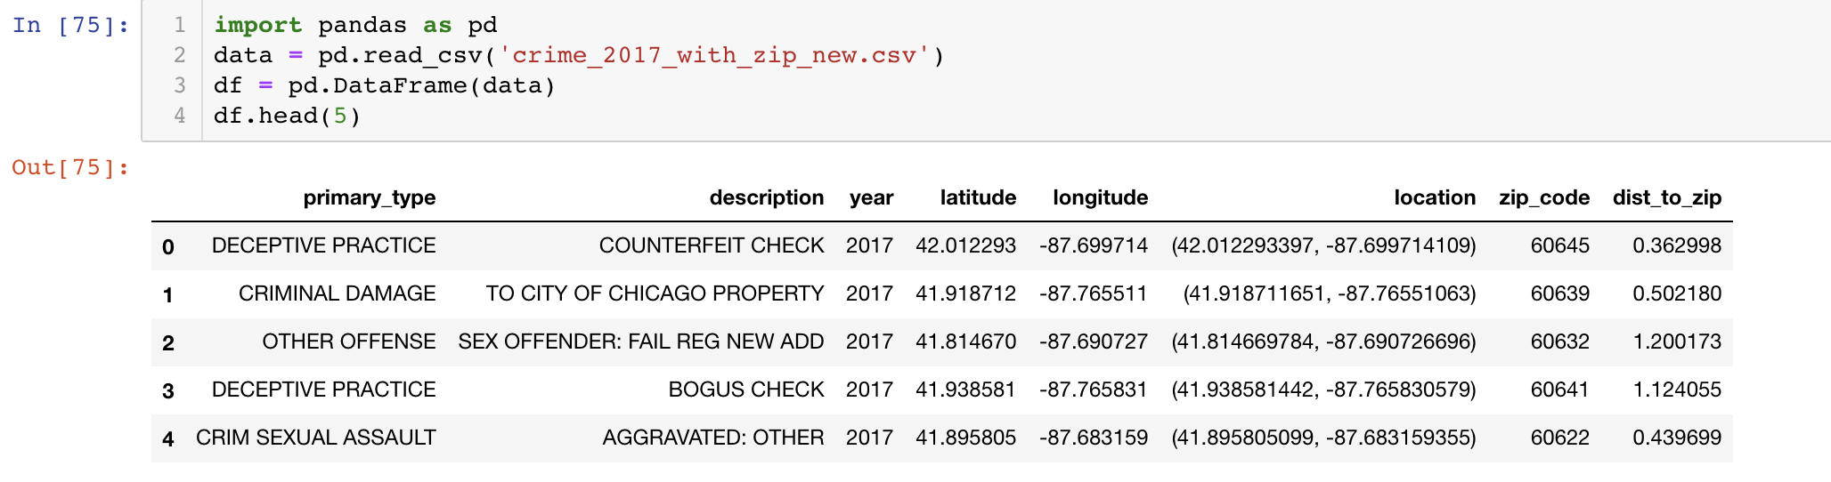
Data Cleansing Results
Completed data sets contains clean data with columns we need to perform further analysis.
Notes:
Eddie

Slide 6
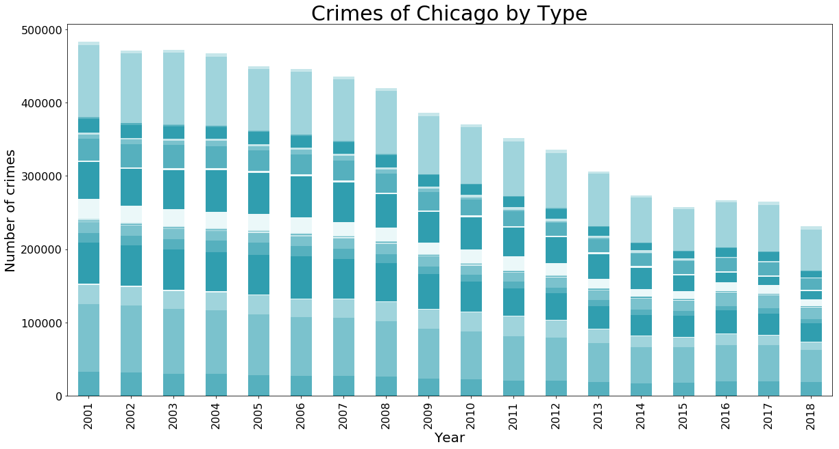
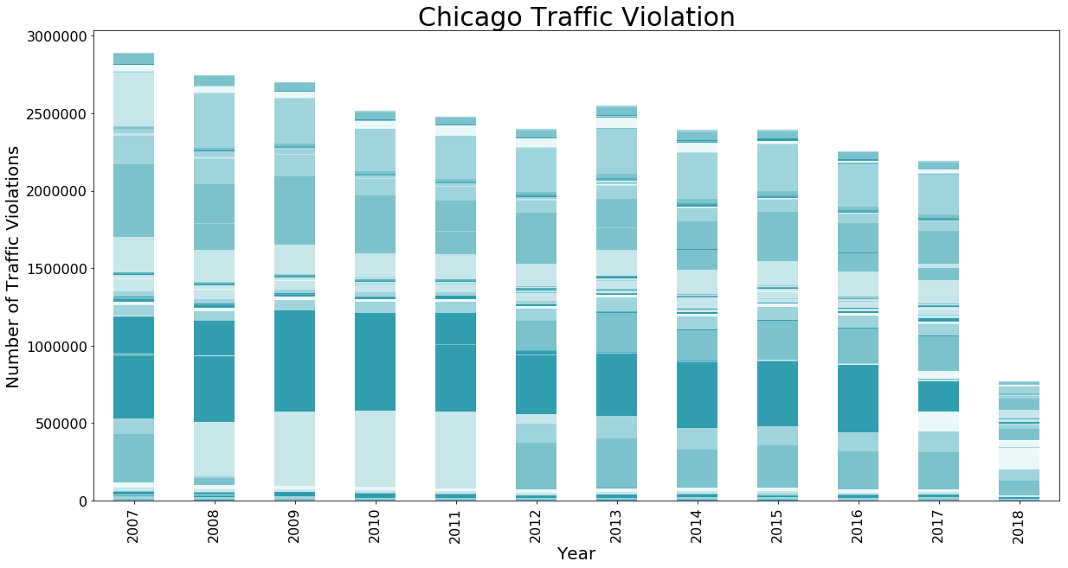
Our Preliminary Findings:
Crimes in Chicago has been decreasing over the years; and coincidentally, traffic violations is also trending in that general direction over the years.
Notes:
Thanh

Slide 7
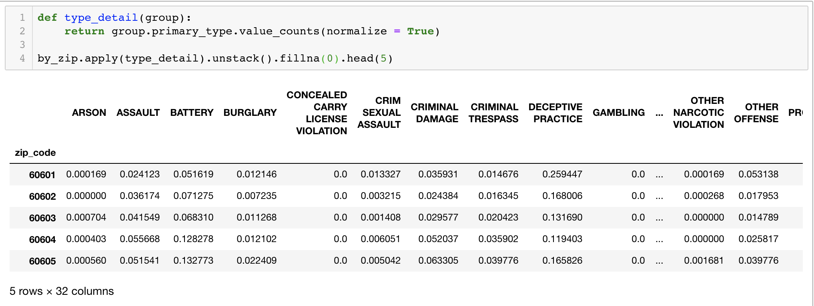
Crime Type Composition by Zip Code
The result is very informative, indicating some areas have more concentrated crime types like theft while others are more spread across different types.
This information can be helpful for police dept to design reinforcement allocation in different areas.
Notes:
Eddie

Slide 8
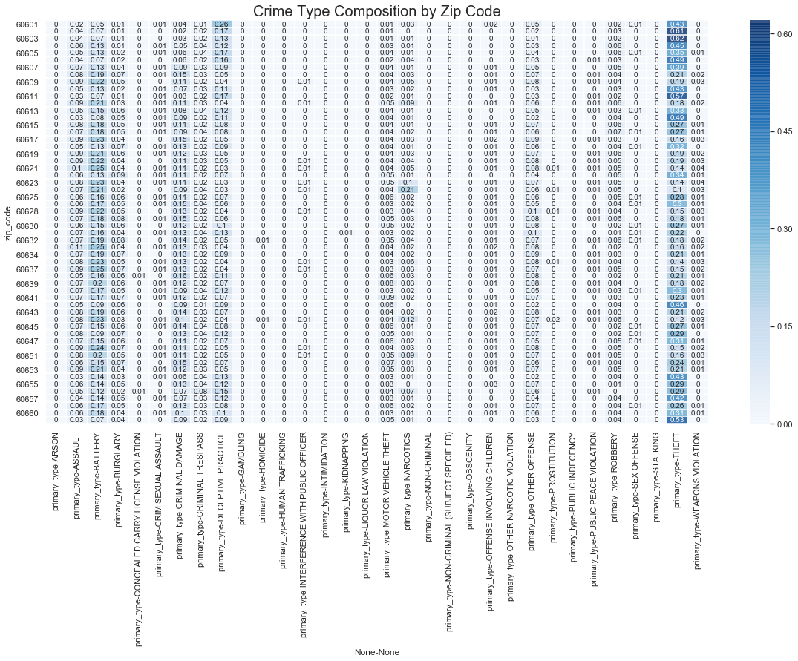
Heat Map
Notes:
Eddie

Slide 9
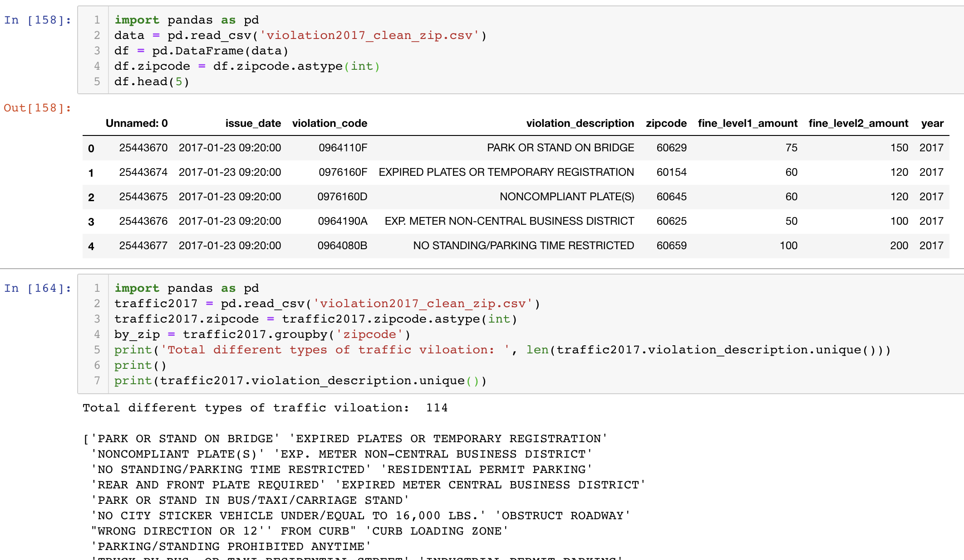
Inconsistent Traffic Violation Types
114+ different types recorded for year 2017
Standardized violation types will provide significant improvement on data analysis and workforce optimization.
Notes:
Eddie

Slide 10
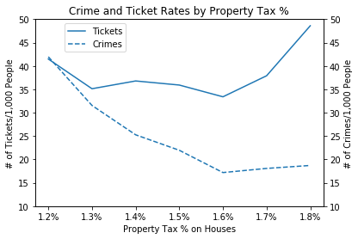
Relationship of Tax Rates to Crime or Ticket Rates
Tax rates in Chicago ranged from 1.2% to 1.8%
Data grouped for all data sets to prepare for this analysis
Notes:
Jon

Slide 11
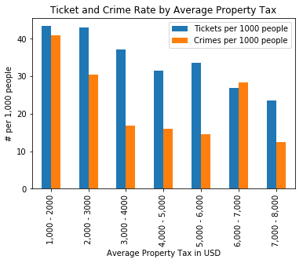
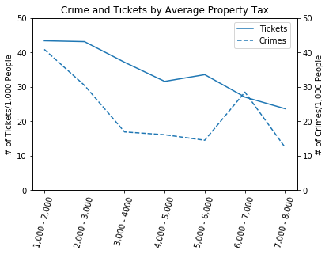
Relationship of Median House Value Tax to Crime or Ticket
Notes:
Jon

Slide 12
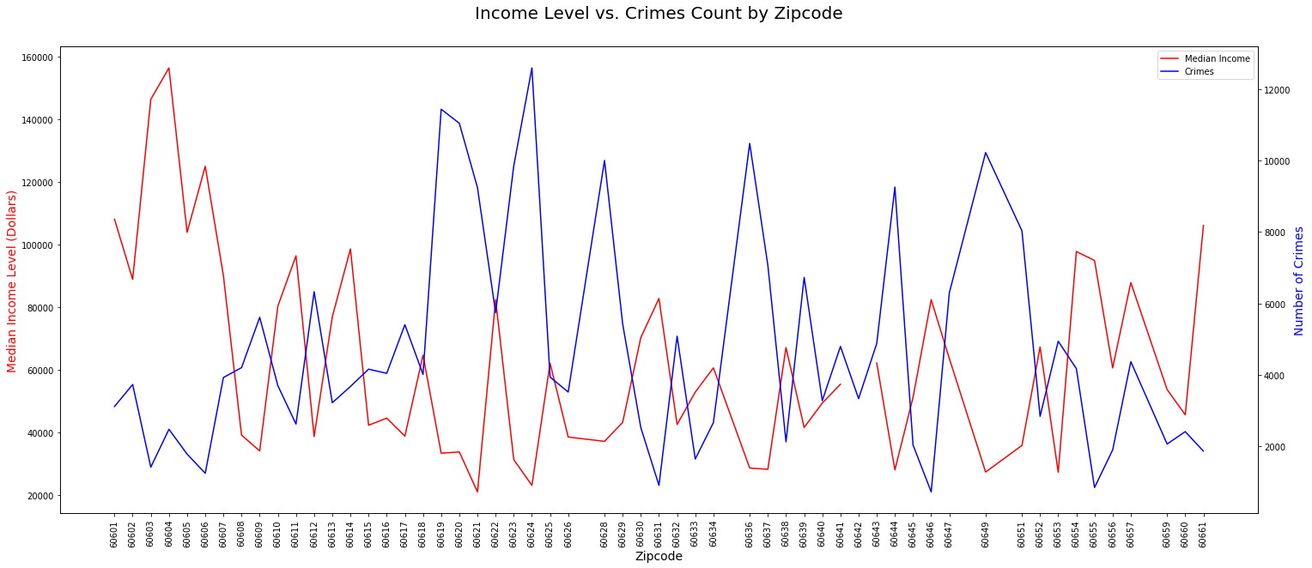
Relationship of Median Income to Crimes
Notes:
TL’s notes:
Indication that poorer neighborhoods have a tendency for more crimes.

Slide 13
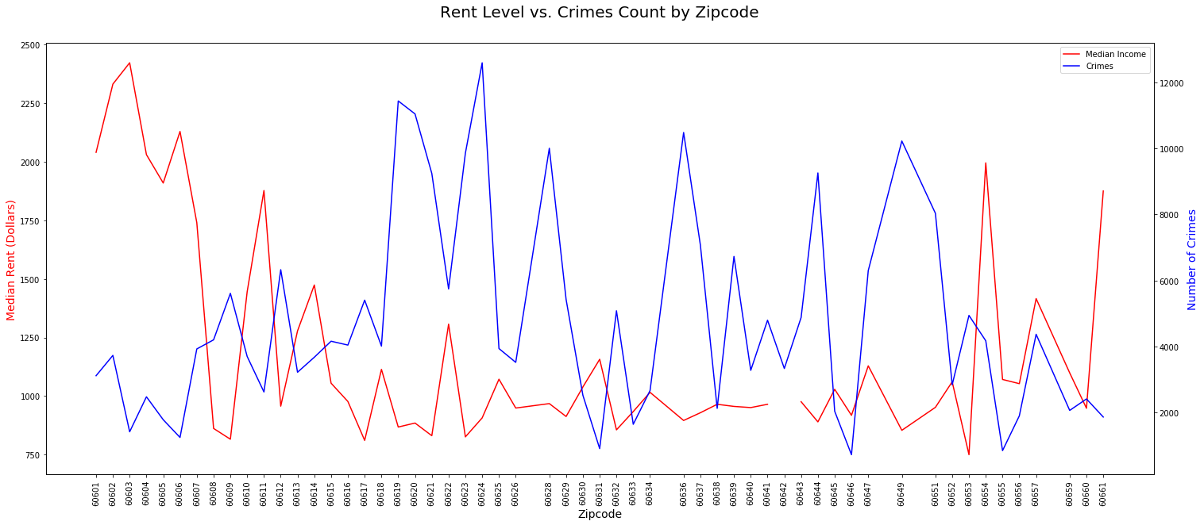
Relationship of Median Rent to Crimes
Notes:
TL’s notes:
Indication that poorer neighborhoods have a tendency for more crimes.

Slide 14
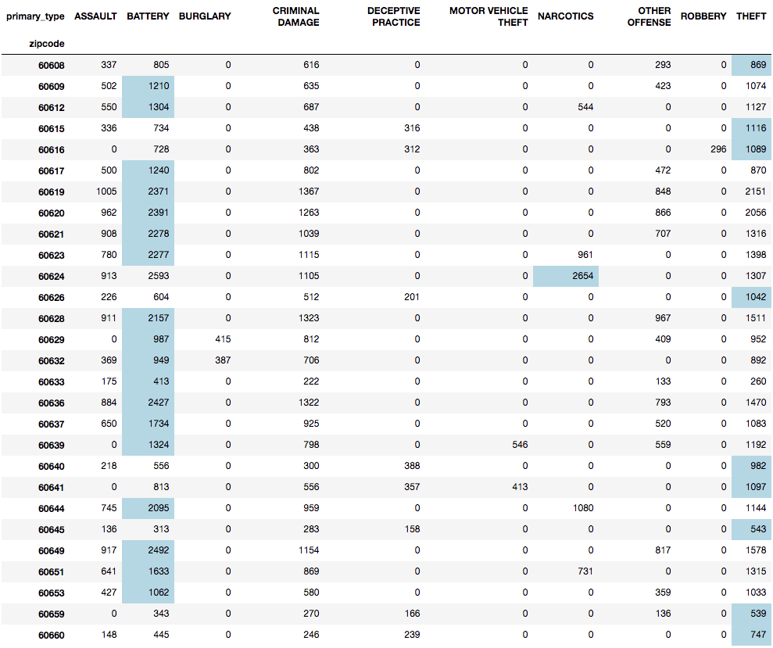
Top 5 Crime Types in Low Income Neighborhoods
This tables shows top 5 crime types in neighborhoods with median income level <= $60,000
* Top crime within the Top 5 crime types highlighted in blue
Notes:
TL’s notes:
Filtered for high crimes and low income level neighborhood.
This will provide guidance on what type of police forces should be focused in which neighborhoods

Slide 15
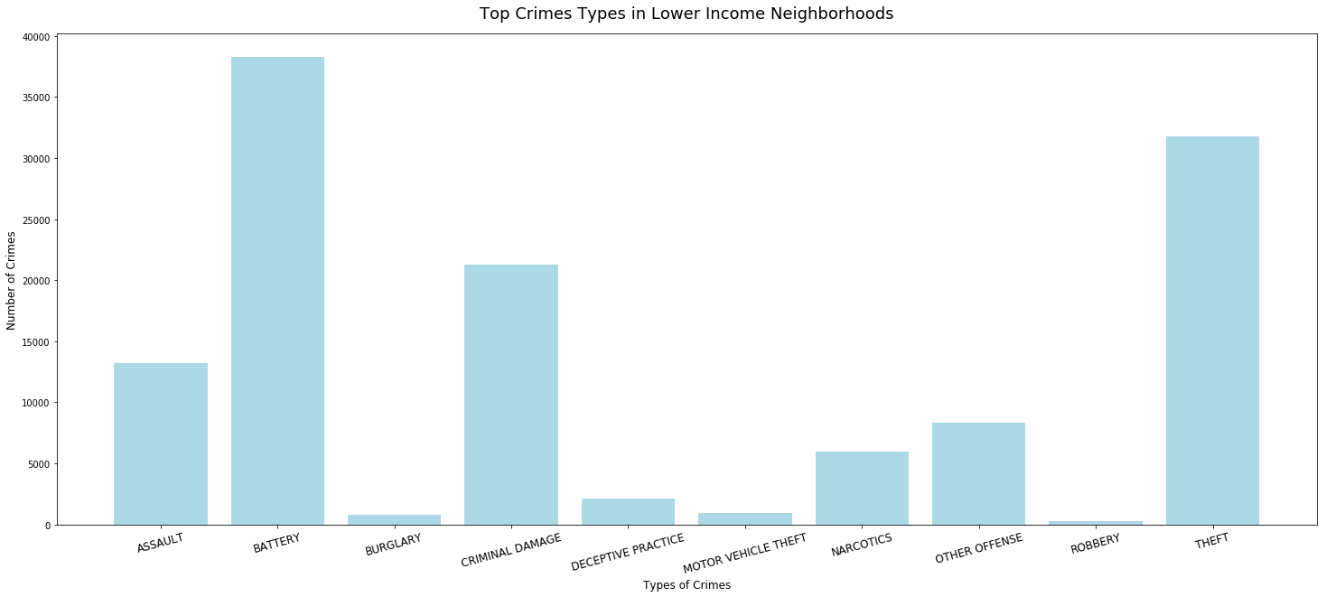
Top Crimes Types in Low Income Neighborhoods
Notes:
TL’s notes:
This will provide guidance on what type of police forces should be focused in which neighborhoods

Slide 16
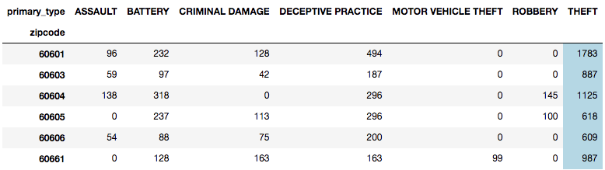
Top 5 Crime Types in High Income Neighborhoods
This tables shows top 5 crime types in neighborhoods with median income level >= $100,000
* Top crime within the Top 5 crime types highlighted in blue
Notes:
TL’s notes:
Filtered for high crimes and low income level neighborhood.
This will provide guidance on what type of police forces should be focused in which neighborhoods

Slide 17
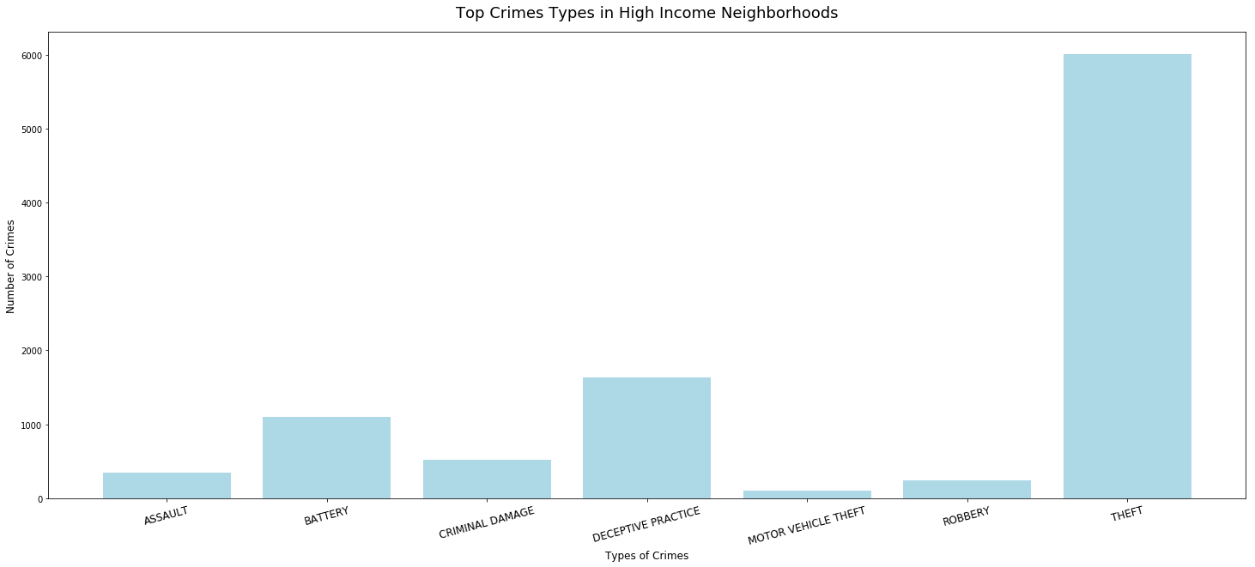
Top Crimes Types in High Income Neighborhoods
Notes:
TL’s notes:
This will provide guidance on what type of police forces should be focused in which neighborhoods

Slide 18
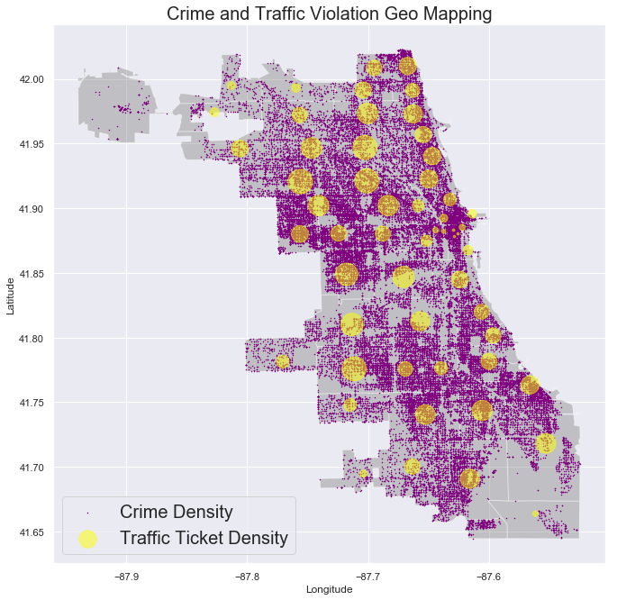
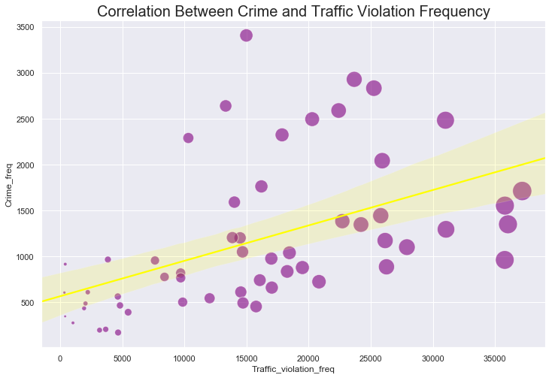
Deep Analysis:
Geo Mapping provided a visual proof of the correlation between traffic violation and non-traffic crime
areas with higher traffic violation occurrence tend to have higher crime rate, and vice versa
Regression analysis further proves the hypothesis
Notes:
Eddie

Slide 19
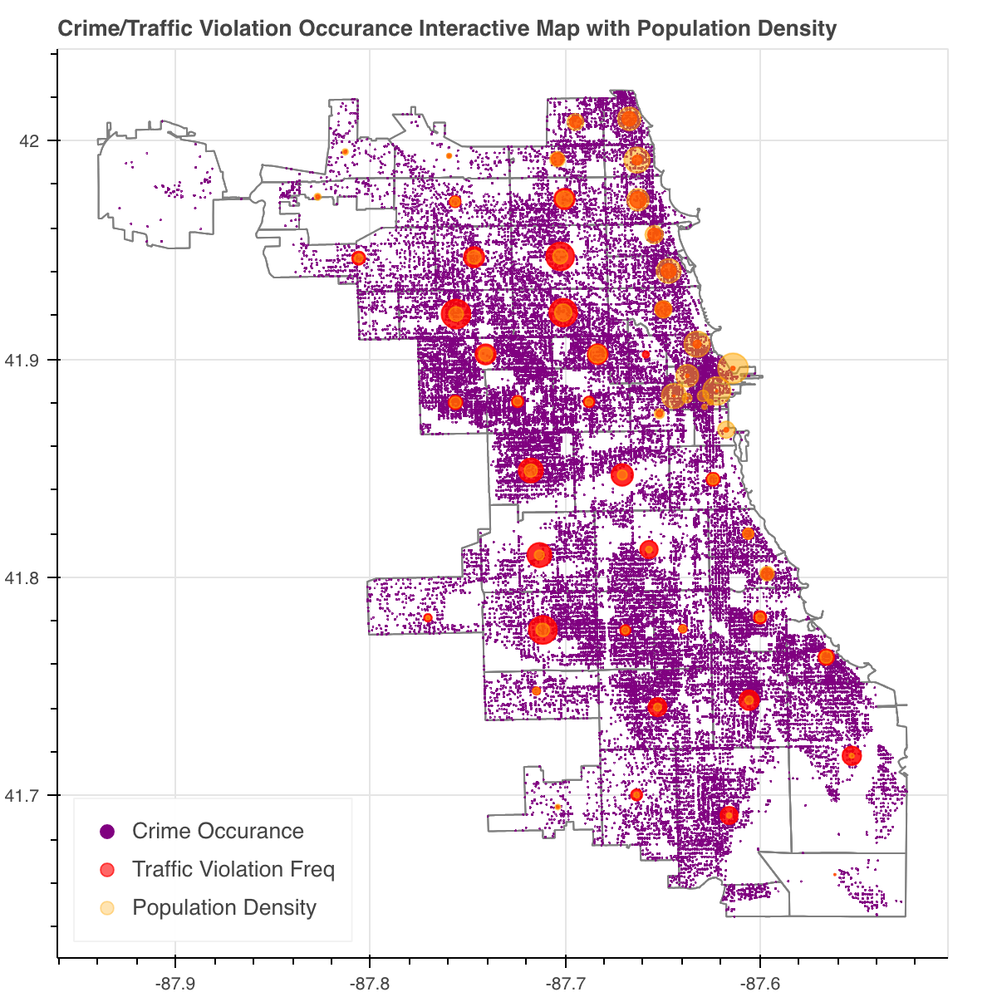
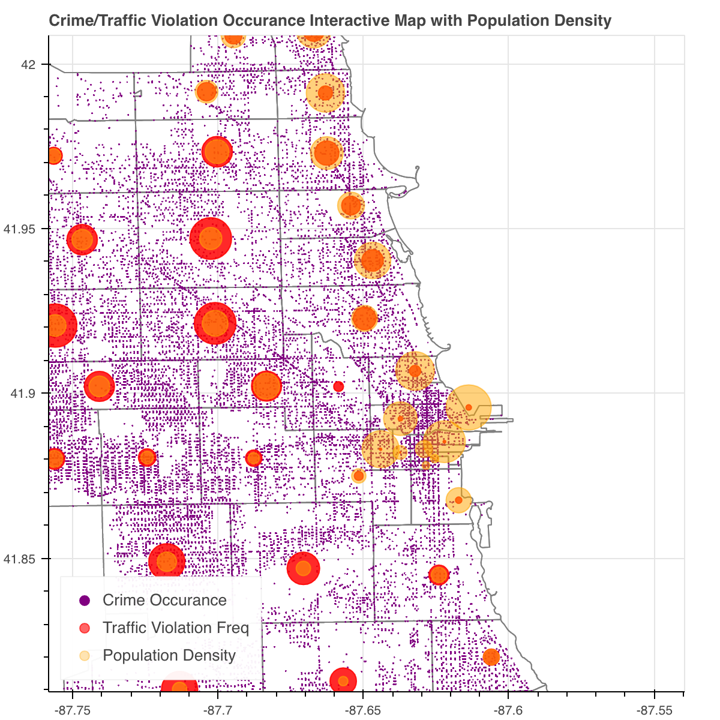
More Interesting Findings
Areas with high population density might have less people driving, therefore, less traffic violation, but higher crime occurrence
Urban areas with lower average income and higher unemployment rate might present higher crime occurrence with lower traffic violations. (Click image below to open dynamic crime map)
Notes:
Eddie

Slide 20
Actionables
Findings help law enforcement to better manage the allocation of the police force
Technologies to monitor and deter traffic violations in rural areas
Police force to prevent hard crimes in urban areas
Help Government and city planning to better neighborhoods that needs a little more TLC

Slide 21

Questions ...

